Slide 1
The God Teacher Archetype
Learn, you will.

Slide 2
Definition/Characteristics
This story involves an individual with great knowledge; benevolent (kind and helpful) and charitable, or he can be tricky and evil (malevolent). He is willing to share his wisdom and teach people the answers to hidden mysteries.

Slide 3
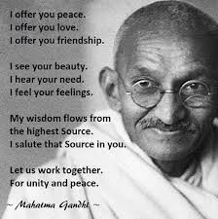
Gahndi
Leader of Indian nationalism in British ruled India
Promoted non-violent civil disobedience
Led India to independence and inspired movements for civil rights and freedom across the world

Slide 4
The God Teacher is a bridge
He acts as an intermediary--a bridge between humans and a divine power.

Slide 5
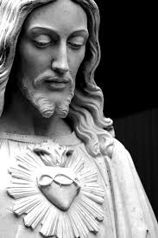
Jesus
According to Christian mythology he is the son of God
Sent to earth to spread the message of God – love
Died for man’s sins
Resurrected from the dead

Slide 6
Values
He is a model for human behavior. He also influences human behavior and suggests the values of the society.

Slide 7
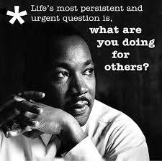
Martin Luther King Jr.
American clergyman
Leader in the Africian-American civil rights movement
Best known for his role in the advancement of civil rights using non violence
Assassinated April 4 1968

Slide 8
Many forms
He may take the form of animals, teachers, visionaries, political or religious leaders, and sport or film idols.

Slide 9
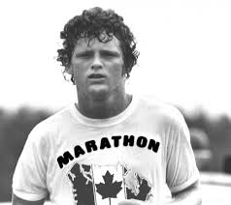
Terry Fox
Athlete
Humanitarian
Cancer research activist
Embarked on a cross-Canada run to raise money and awareness for cancer research

Slide 10
Sacrifice
The god teacher must ultimately sacrifice something of themselves
In early myths they were punished for revealing mysteries

Slide 11
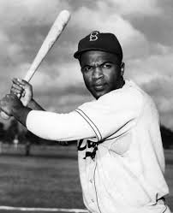
Jackie Robinson
http://www.youtube.com/watch?v=VnUcN0txo5g

